Slide 1

Project Presentation
“Personalized Academic & Career Roadmap Platform”
ADT23SOCB1504:- Abhijeet Shirke
ADT23SOCB0625:- Mrunali Patil
ADT23SOCB1592:- Jagruti Ghonge
ADT23SOCB1506:- Anas Shaikh
Guided by
Prof. Palash Sontakke (Information Technology)
Department of Information Technology, MITSoC, Loni Kalbhor

Slide 2
Outline
Introduction
Problem Statement
Objectives
Concepts & Methods
Literature Review
Identification of gaps & scope of work
Implementation
Reference
Q&A
Department of Information Technology, MITS0C, Loni Kalbhor

Slide 3
Introduction
In today’s fast-changing job market, it’s often challenging and time-consuming for people to plan a clear path for their careers. Traditional career planning methods are usually generic and don’t offer personalized advice. Our website solves this problem by using advanced artificial intelligence to create easy-to-follow, step-by-step career roadmaps tailored to each individual’s goals.
We focus on two main features: generating these personalized roadmaps using AI, and helping users connect with experienced mentors in their desired fields. Together, these features provide practical guidance and personal support to help users achieve their career aspirations more effectively and confidently.
Department of Information Technology, MITSoC, Loni Kalbhor

Slide 4
Problem statement
Many individuals find it difficult to plan their career paths clearly and effectively. Traditional career guidance methods are often time-consuming and lack personalized recommendations tailored to unique goals. Additionally, access to experienced mentors is limited for many users. There is a need for a user-friendly platform that generates customized career roadmaps using advanced technology and connects users with qualified mentors, enabling them to make informed decisions and achieve their career objectives more efficiently.
Department of Information Technology, MITS0C, Loni Kalbhor

Slide 5
Literature Review
Generate personalized roadmaps: Use user-provided goals to create step-by-step learning and career plans tailored to skills, timeline, and background.
Connect to mentors: Match users with experienced mentors for advice, reviews, and real-world insights that complement AI suggestions.
Improve accessibility and speed: Deliver instant, easy-to-understand guidance to reduce time spent searching for reliable career paths.
Ensure relevance and quality: Validate and refine AI outputs through prompt engineering, post-processing, and mentor feedback to keep recommendations accurate and practical.
Protect privacy and ethics: Secure user data, provide transparency about AI limitations, and mitigate bias in recommendations.
Department of Information Technology, MITSoC, Loni Kalbhor

Slide 6
Concepts & Methods
Concepts:
Personalized Roadmap Generation:
Using user input and AI language models, generate individualized, stepwise career plans to guide learning and professional growth.
Mentor Connectivity:
Facilitating meaningful connections between users and experienced professionals to provide personalized advice and real-world insights.
Natural Language Processing (NLP):
Employing NLP models (e.g., GPT) to interpret free-text inputs and create coherent, actionable guidance.
User-Centric Design:
Ensuring an intuitive UI/UX that simplifies complex career planning through clear visualizations and interactive features.
Data Security and Ethics:
Protecting user privacy and addressing AI bias by secure data handling and transparency around AI's role and limitations.
Methods:
Input Collection and Validation:
Frontend form gathers user's career goals; backend validates and preprocesses the data.
Prompt Engineering:
Backend constructs effective prompts embedding user goals to guide AI text generation towards structured roadmaps.
AI Inference:
Integrate with AI models (either via APIs or local inference) to generate text-based career roadmaps.
Data Parsing and Formatting:
Process AI output to convert raw text into user-friendly formats—lists, timelines, or cards.
Mentor Matching:
Use algorithms or manual curation to pair users with suitable mentors based on expertise, interests, and availability.
Department of Information Technology, MITSoC, Loni Kalbhor

Slide 7
Implementation
Short Implementation Summary:
Use React.js for frontend forms and display.
Backend with Node.js/Express to handle API requests and user authentication.
Deploy local AI models (e.g., LLaMA 2) using Hugging Face for roadmap generation.
Store user data, roadmaps, and mentors in MongoDB or PostgreSQL.
Implement mentor search, connection requests, and chat features.
Department of Information Technology, MITSoC, Loni Kalbhor

Slide 8
Identification of gaps & scope of work
The project focuses on developing a web-based platform that provides personalized career guidance through AI-generated roadmaps and facilitates mentorship connections. It addresses the challenge of navigating complex career paths by automating roadmap generation tailored to individual goals and offering human mentorship support to enhance decision-making and skill development.
Scope of Work
User Interface Development:
Design and implement an intuitive frontend where users can input career goals, view generated roadmaps, and connect with mentors.
Backend Development:
Develop APIs to handle user requests, integrate with AI models for roadmap generation, and manage mentor-mentee connections.
AI Integration:
Integrate advanced NLP models to process user input and generate stepwise career roadmaps.
Mentor Management:
.
Department of Information Technology, MITSoC, Loni Kalbhor

Slide 9
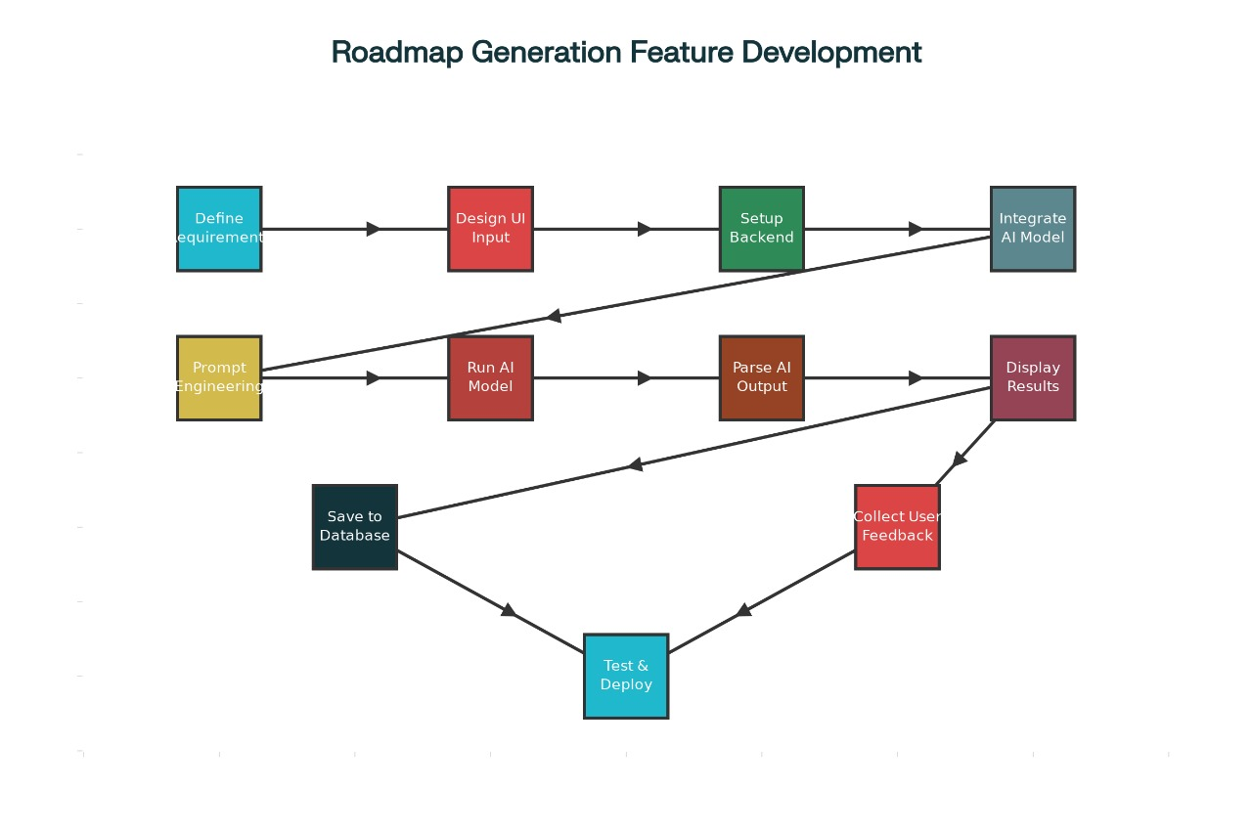
FLOWCHART
.
Department of Information Technology, MITSoC, Loni Kalbhor

Slide 10
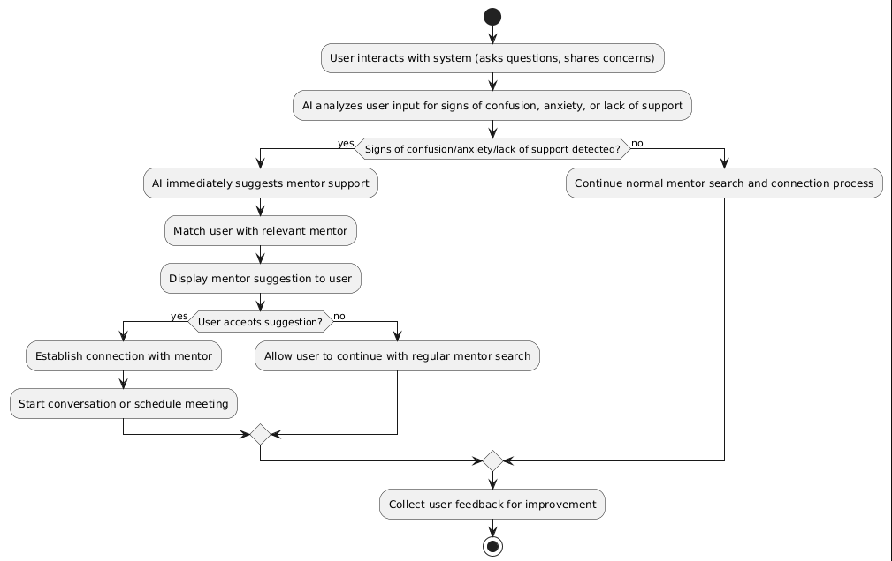
.
Department of Information Technology, MITSoC, Loni Kalbhor

